Slide 1
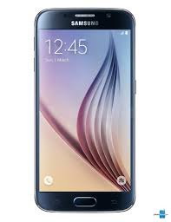




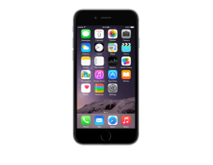







You create an app for Android
You get an app for Android phones (Samsung, Nexus, Motorola, etc.)
You create an app for Windows
You get an app for Windows Phones (Nokia)
You create an app for Apple
You get an app for iPhones
3 different technologies to learn
Takes time
Excellent result: we get 3 « real apps »
NATIVE:
HYBRID:
We create one project, using the same kind of methods as for creating web pages
The app is actually contained in the web browser of the phone. It looks like a native app.
Web brower used by any phone
Just one project to develop
Techno is well known
Fit for most purposes
NO NAME:
You get an app for Android phones (Samsung, Nexus, Motorola, etc.)
We create a project, using a programming language called Java
Codename One takes your project and create from it « real » apps for Apple, Android and Windows Phones.
You get an app for Windows Phones (Nokia)
You get an app for iPhones

Slide 2




Google group
+
website (where there is
a manual and videos)
post your questions on the forum!
Inspiration to design your mobile app
The largest forum for all questions related to coding.

Slide 3




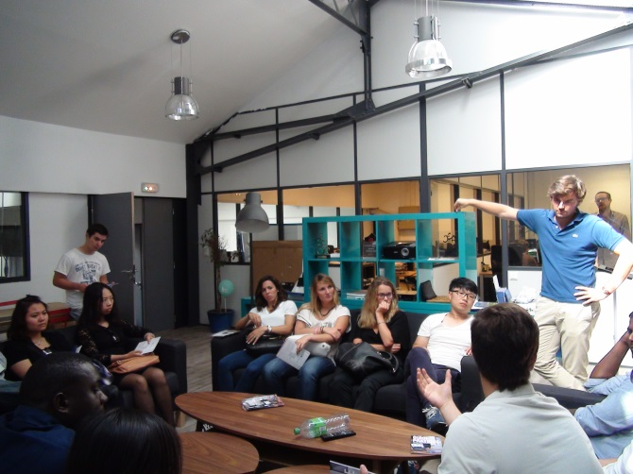
Participate in meetups in your city!
Join a coworking space
Release early,
Release often
Apply for an incubator

